Slide 1
Housing Price Prediction
Nicholas Roller

Slide 2
The Problem
HouseX, a new startup, is looking to make an online tool that help residential home buyers or sellers determine a value for a home.
Our goal is to determine a predictive model that takes various home features as input and provides an estimate for the home’s value
What features most affect the value of a home?
How accurate of a model can we produce?
Can this tool also provide marginal value increases for customers looking to renovate?

Slide 3
What Factors Affect a Home’s Value?
We hypothesized going in that square footage, or the size of the home, would be one of the biggest factors
Lot size should also play a role
Number of bedrooms/bathrooms
Quality of home or particular components
Age of home

Slide 4
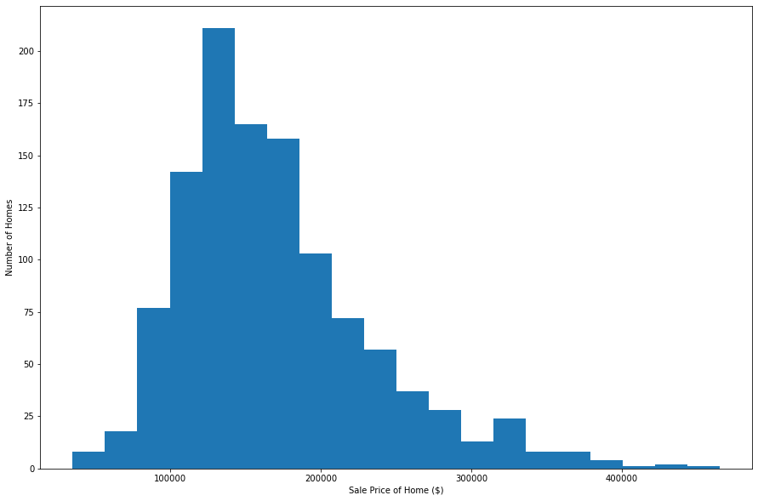
The Data
We looked at a dataset with nearly 1200 home sales, each with 79 different variables related to the home and the sale of said home.
As you can see, they had a rather normal distribution with a slight tail to the right.

Slide 5
Feature Engineering
Original data set had several date features:
Year/Month of sale
Year house was built
Year garage was built
Year of remodel (if any)
Had to convert these to ages so models could properly process.
The age of a home’s remodel defaulted to the house’s age if no remodel was performed
Decided to engineer a new feature that takes the mean of the house age and remod age
This feature had a greater correlation with sale price than the two original and was used in our final model

Slide 6
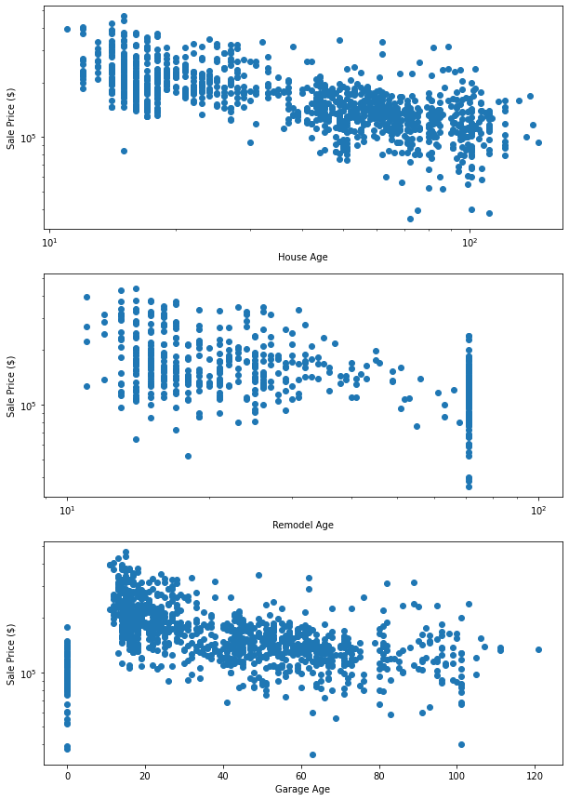
Age Features vs Sales Price
All have negative correlation
Large number of 0 values for garage are homes without garages
Large number of high aged remodels are houses built in 1950 without remodels
*Notice these are on a log-log scale

Slide 7
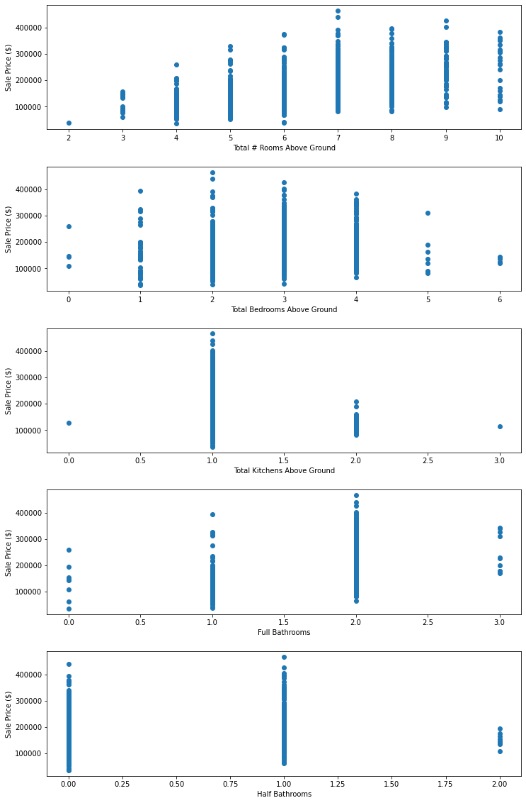
Rooms vs Price
We can see a logical relationship between total number of rooms above ground with sales price.
However, there’s a strange drop off for total number of bedrooms above 3.
We see this manifest itself later one when we begin looking into feature importance.

Slide 8
Bathrooms vs Price
Full baths have an expected positive relationship with price up until 3 full baths, but we don’t have many data points for 4 full baths
The number of half baths don’t seem to have a very strongly positive relationship to price

Slide 9
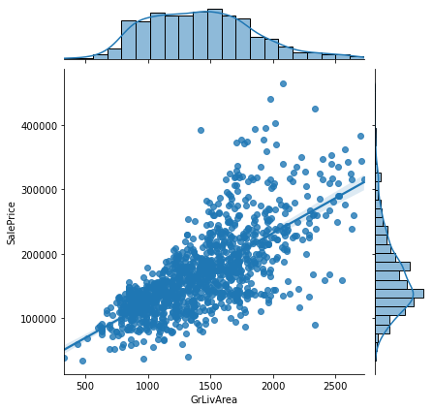
Square Footage vs Price
Our guess as best predictor for house sale price
No surprise it shows a strong positive correlation with sale price
Bigger homes = bigger price

Slide 10
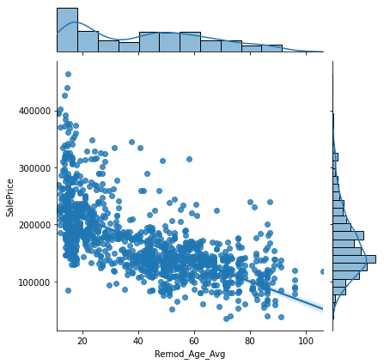
Age vs Price
As mentioned before, the home’s age and the age of its remodel have a strong negative correlation to sale price

Slide 11
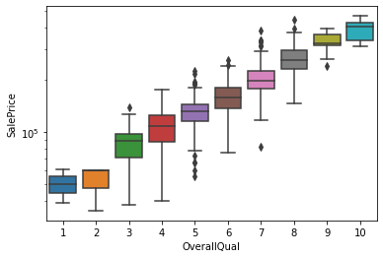
Overall Quality vs Price
One of the strongest predictors was a 1-10 rating of the home’s overall quality
We can see this relationship represented strongly here in the boxplot of this feature versus sale price.

Slide 12
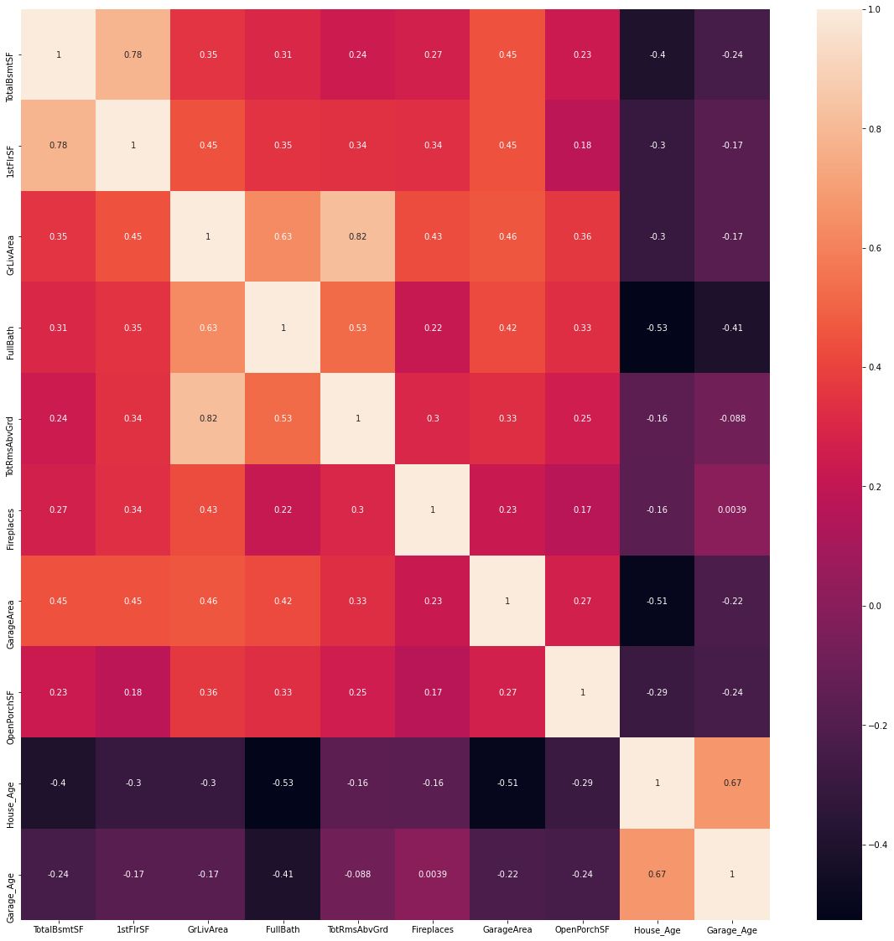
Correlation Heatmap
House and Garage age logically have a negative correlation to Sale Price

Slide 13
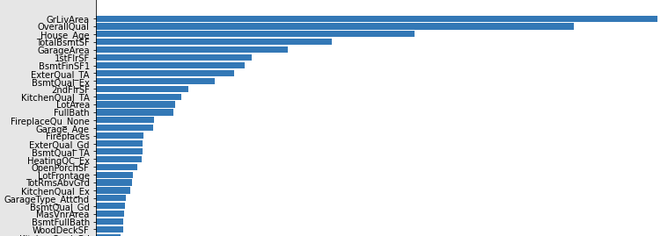
Feature Importance
We needed to narrow down our large number of features to the top 10 or so
We utilized hyperparameter tuning with Random Forest model in combination with permutations to determine the most important features to use with our model

Slide 14
The Final Model
Between a simple linear regression, random forest regression, lasso and ridge regression models, the random forest model performed the best
The mean absolute error of our final model was $16,650, which means our model’s predictions were withing +/- 8,325 of the house’s actual sale price
CV Score on the train sample was 0.98 versus 0.88 on the test sample which may indicate overfitting

Slide 15
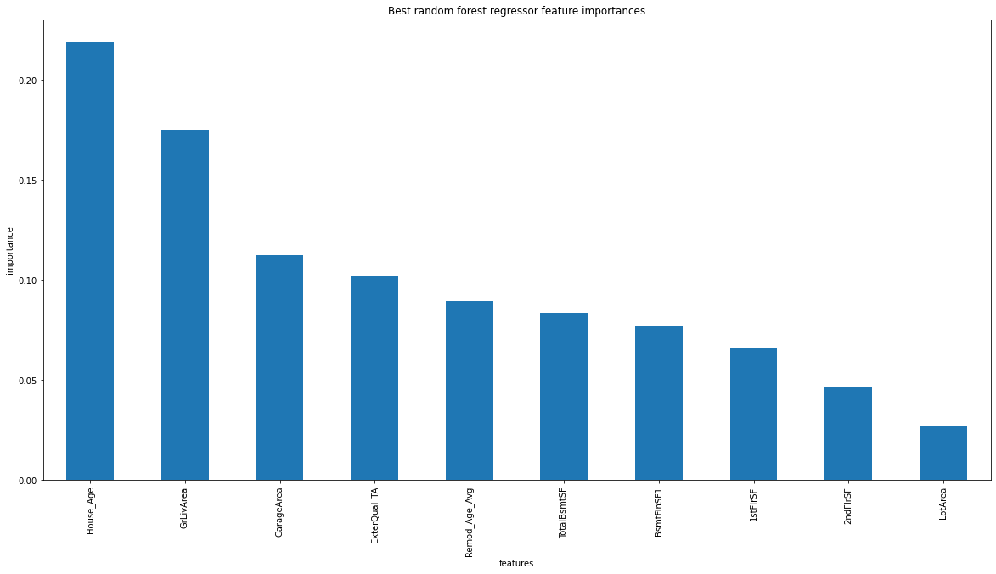

Slide 16
Conclusion
We were able to utilize supervising machine learning to home in on the most influential features of a home and produce a regression model that could predict a home’s price with roughly 90% accuracy.
We determined random forest to be the best model for this and the most influential features included:
General living square footage
Home’s Age
Overall Quality of the home
Size of the garage
Size of the basement

Slide 17
Thoughts for the future
How much does highly correlated independent variables affect our model, and could we achieve a more accurate model by removing some of these? One example being 1st and 2nd floor square footage being correlated to GrLivArea square footage, as it is basically their sum. Also 1st floor square footage is highly correlated with basement square footage since most basements are only as large as the foundation of the home.
Can we use this model to build a tool to predict the change in a home’s value by altering it’s current features.
i.e. renovating and adding square footage, etc.
Is our final model overfit to the training data?
We noticed a strong correlation with house prices based on neighborhoods, but felt it wasn’t general enough for the purpose of our model. However, in the future this could certainly be used in models targeting a more niche housing market, specific to a certain town or city.
Hyperparameter tuning of our random forest model was quite computationally expensive, but feel that with more time or computing power, parameters could potentially be tweaked a bit more.

